Slide 1




NEXT GEN EMPLOYABILITY PROGRAM
Creating a future-ready workforce
Team Members
College Name
Student Name : P. Bharathi
Student ID : 623521104007
6235 - AVS College of Technology

Slide 2

CAPSTONE PROJECT SHOWCASE
Project Title
Building Bus Reservation System using Python and Django
Abstract | Problem Statement | Project Overview | Proposed Solution | Technology Used | Modelling & Results | Conclusion

Slide 3
Abstract
The Bus Reservation System (BRS) is a web-based application developed using Python and Django framework.
Aimed at facilitating the booking and management of bus tickets, providing convenience and efficiency to users.
Key features include user registration/authentication, bus and route management, seat reservation, payment integration, and reservation management.
Source :

Slide 4
Problem Statement
Reservation process allows users to select seats, make payments securely through integrated payment gateways, and receive email notifications for booking confirmations and updates.
Administrators have access to a dashboard for monitoring bookings, managing buses/routes, viewing sales reports, and performing administrative tasks efficiently.
Designed for scalability, flexibility, and easy customization to meet evolving needs of bus operators and passengers.
Leveraging Python and Django for robustness, reliability, and seamless user experience.
Source :

Slide 5
Project Overview
The Bus Reservation System (BRS) is a web-based application developed using Python and Django framework, aiming to streamline the booking process and enhance the management of bus reservations.
The primary goal of the project is to create a user-friendly and efficient platform for booking bus tickets, providing accurate information to passengers, and empowering bus operators with effective management tools.
Source :

Slide 6
Proposed Solution
Develop a comprehensive Bus Reservation System (BRS) using Python and Django framework to streamline the booking process and enhance reservation management.
Key Components:
User Management
Bus and Route Management
Reservation Management
Admin Dashboard
Source :

Slide 7


Technology Used
Front-end
Back-end
Source :

Slide 8
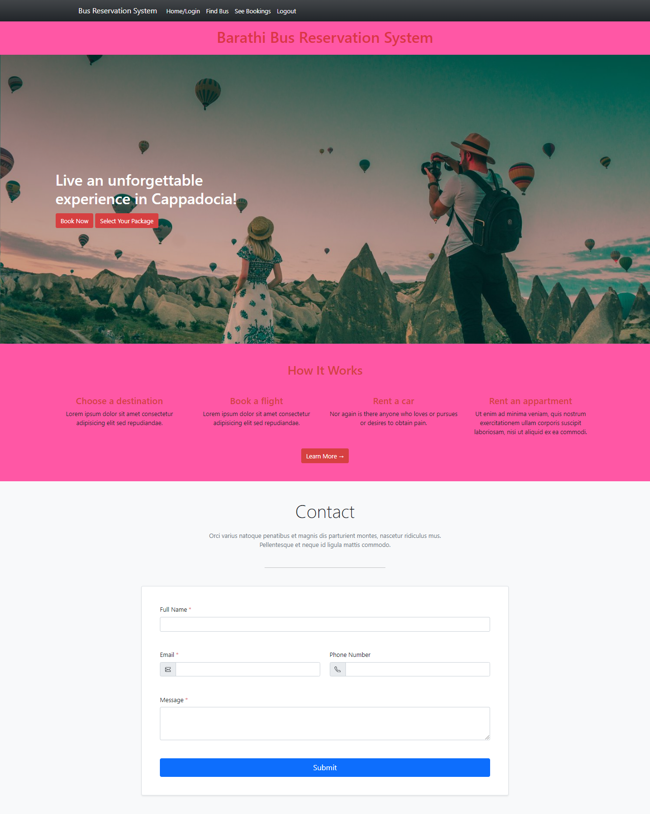
Modelling & Results
Source :

Slide 9
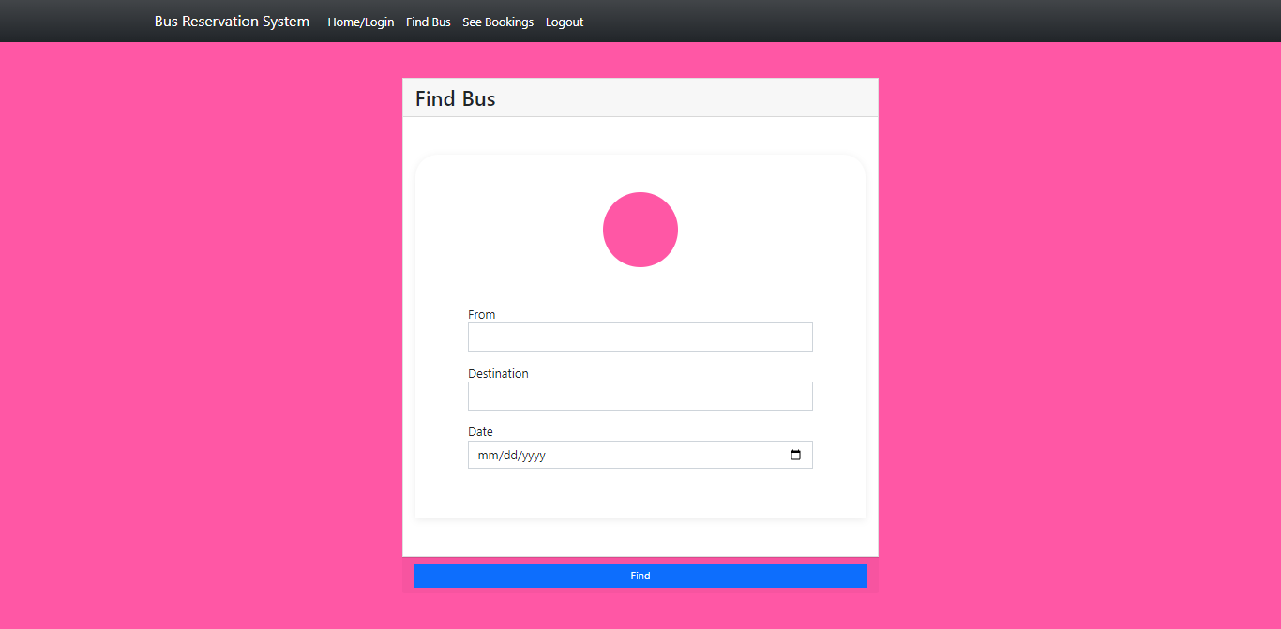
FIND BUS

Slide 10
HOME PAGE

Slide 11
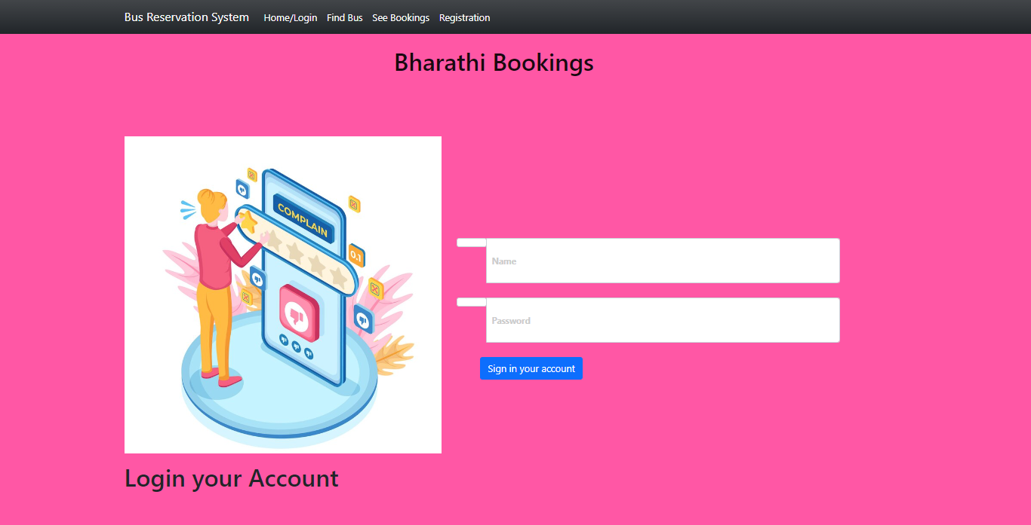
LOGIN PAGE

Slide 12
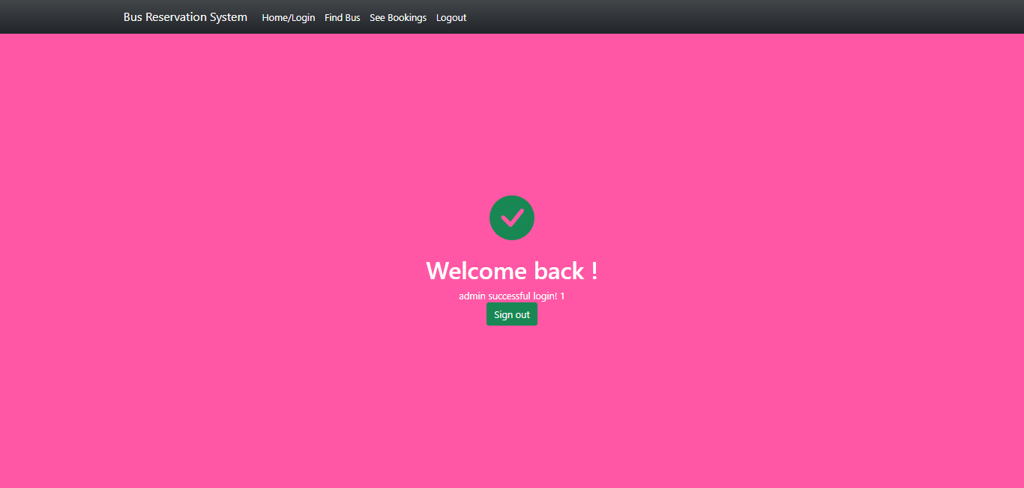
THANKS PAGE

Slide 13
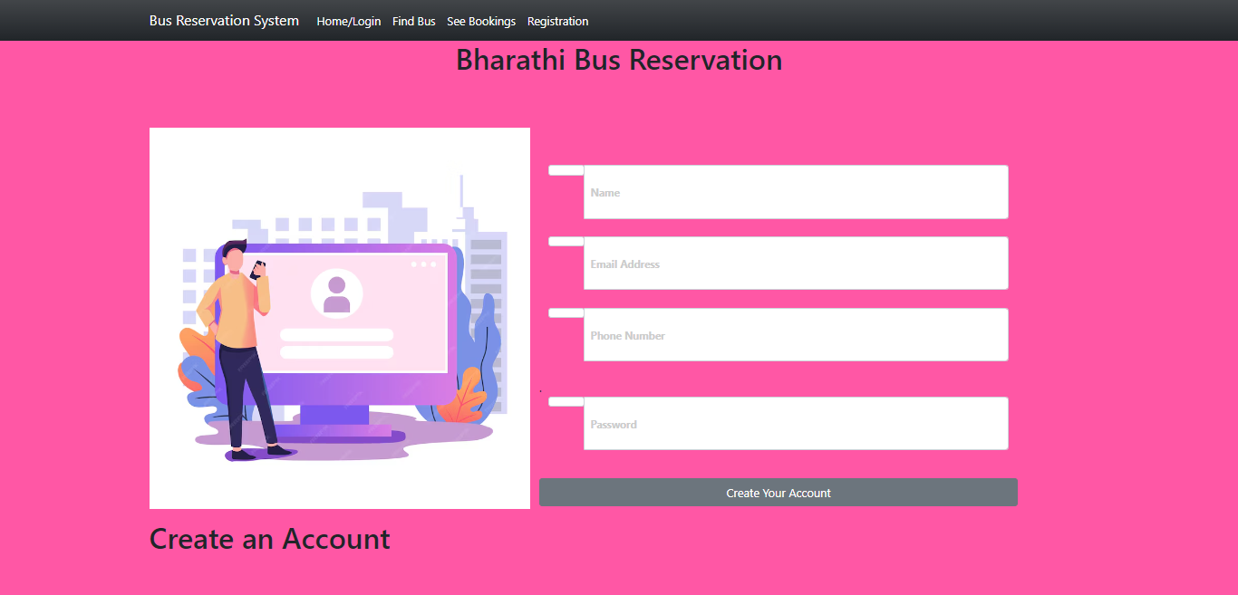
REGISTRATION PAGE

Slide 14
Future Enhancements:
Promote environmental initiatives for sustainable travel.
Implement IoT sensors for predictive maintenance.
These enhancements aim to improve the overall functionality, user experience, and sustainability of the Bus Reservation System.

Slide 15
Conclusion
In conclusion, the proposed Bus Reservation System (BRS) offers a comprehensive solution for efficient bus ticket booking and management.
Implement IoT sensors for predictive maintenance.
These enhancements aim to improve the overall functionality, user experience, and sustainability of the Bus Reservation System.
Source :

Slide 16
Thank You!
Notes:
Thank You !!

